Slide 1
Logic and Proofs
Proofs

Slide 2
Predicate Logic - Introduction
We will study the following sub topics
Valid Arguments
Rules of Inference
Proof Methods
Proof Strategies

Slide 3
Proofs
Validity of Arguments

Slide 4
Proofs – Valid Arguments
Introduction

Slide 5
Proofs – Valid Arguments
Introduction
Argument:

Slide 6
Proofs – Valid Arguments
Introduction
Argument: a sequence of statements (premises/rules) that end with a conclusion

Slide 7
Proofs – Valid Arguments
Introduction
Argument: a sequence of statements (premises/rules) that end with a conclusion
Valid Argument:

Slide 8
Proofs – Valid Arguments
Introduction
Argument: a sequence of statements (premises/rules) that end with a conclusion
All propositions except the final one in the argument are called premises and the final proposition is called the conclusion.
Valid Argument: the conclusion, or final statement of the argument, must follow from the truth of the preceding statements.
That is, an argument is valid if and only if it is impossible for all the premises to be true and the conclusion to be false.

Slide 9
Proofs – Valid Arguments
Example 01

Slide 10
Proofs – Valid Arguments
Example 01
“All men are mortal”

Slide 11
Proofs – Valid Arguments
Example 01
“All men are mortal”
“Socrates is a man”

Slide 12
Proofs – Valid Arguments
Example 01
“All men are mortal”
“Socrates is a man”
Therefore “Socrates is mortal”

Slide 13
Proofs – Valid Arguments
Example 01
“All men are mortal”
“Socrates is a man”
Therefore “Socrates is mortal”
Propositions

Slide 14
Proofs – Valid Arguments
Example 01
“All men are mortal”
“Socrates is a man”
Therefore “Socrates is mortal”
Propositions
Man(x): Propositional function represents “x is a man”

Slide 15
Proofs – Valid Arguments
Example 01
“All men are mortal”
“Socrates is a man”
Therefore “Socrates is mortal”
Propositions
Man(x): Propositional function represents “x is a man”
Mortal(x): Propositional function represents “x is mortal”

Slide 16
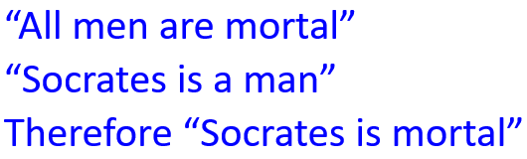

Proofs – Valid Arguments
Arguments

Slide 17
Proofs – Valid Arguments
Arguments
∀x Man(x) → Mortal(x)

Slide 18
Proofs – Valid Arguments
Arguments
∀x Man(x) → Mortal(x)
Man(Socrates)

Slide 19
Proofs – Valid Arguments
Arguments
∀x Man(x) → Mortal(x)
Man(Socrates)
Conclusion

Slide 20

Proofs – Valid Arguments
Arguments
∀x Man(x) → Mortal(x)
Man(Socrates)
Conclusion
Mortal(Socrates)

Slide 21
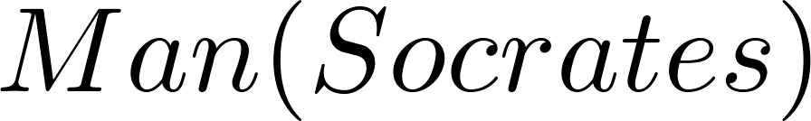
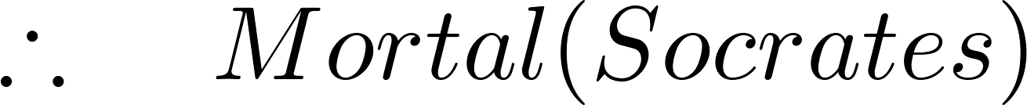
Proofs – Valid Arguments
Arguments
∀x Man(x) → Mortal(x)
Man(Socrates)
Conclusion
Mortal(Socrates)

Slide 22
Proofs – Valid Arguments
Example 02
“If you have a current password, then you can log onto the network”
“You have a current password”
Therefore “You can log onto the network”

Slide 23
Proofs – Valid Arguments
Example 02
“If you have a current password, then you can log onto the network”
“You have a current password”
Therefore “You can log onto the network”
Propositions

Slide 24
Proofs – Valid Arguments
Example 02
“If you have a current password, then you can log onto the network”
“You have a current password”
Therefore “You can log onto the network”
Propositions
p: “You have a current password”

Slide 25
Proofs – Valid Arguments
Example 02
“If you have a current password, then you can log onto the network”
“You have a current password”
Therefore “You can log onto the network”
Propositions
p: “You have a current password”
q: “You can log onto the network”

Slide 26
Proofs – Valid Arguments
Example 02
“If you have a current password, then you can log onto the network”
“You have a current password”
Therefore “You can log onto the network”
Propositions
p: “You have a current password”
q: “You can log onto the network”
Argument & Conclusion

Slide 27
Proofs – Valid Arguments
Example 02
“If you have a current password, then you can log onto the network”
“You have a current password”
Therefore “You can log onto the network”
Propositions
p: “You have a current password”
q: “You can log onto the network”
Argument & Conclusion
p → q

Slide 28
Proofs – Valid Arguments
Example 02
“If you have a current password, then you can log onto the network”
“You have a current password”
Therefore “You can log onto the network”
Propositions
p: “You have a current password”
q: “You can log onto the network”
Argument & Conclusion
p → q
p

Slide 29
Proofs – Valid Arguments
Example 02
“If you have a current password, then you can log onto the network”
“You have a current password”
Therefore “You can log onto the network”
Propositions
p: “You have a current password”
q: “You can log onto the network”
Argument & Conclusion
p → q
p

Slide 30
Proofs – Valid Arguments
Example 02
“If you have a current password, then you can log onto the network”
“You have a current password”
Therefore “You can log onto the network”
Propositions
p: “You have a current password”
q: “You can log onto the network”
Argument & Conclusion
p → q
p
q

Slide 31
Proofs – Valid Arguments
Example 03
“If you have access to the network, then you can change your grade”
“You have access to the network”
Therefore “You can change your grade”

Slide 32
Proofs – Valid Arguments
Example 03
“If you have access to the network, then you can change your grade”
“You have access to the network”
Therefore “You can change your grade”
Propositions

Slide 33
Proofs – Valid Arguments
Example 03
“If you have access to the network, then you can change your grade”
“You have access to the network”
Therefore “You can change your grade”
Propositions
p: “You have access to the network”
q: “You can change your grade”

Slide 34
Proofs – Valid Arguments
Example 03
“If you have access to the network, then you can change your grade”
“You have access to the network”
Therefore “You can change your grade”
Propositions
p: “You have access to the network”
q: “You can change your grade”
Argument & Conclusion

Slide 35
Proofs – Valid Arguments
Example 03
“If you have access to the network, then you can change your grade”
“You have access to the network”
Therefore “You can change your grade”
Propositions
p: “You have access to the network”
q: “You can change your grade”
Argument & Conclusion

Slide 36
Proofs – Valid Arguments
Example 03
“If you have access to the network, then you can change your grade”
“You have access to the network”
Therefore “You can change your grade”
Propositions
p: “You have access to the network”
q: “You can change your grade”
Argument & Conclusion
p → q

Slide 37
Proofs – Valid Arguments
Example 03
“If you have access to the network, then you can change your grade”
“You have access to the network”
Therefore “You can change your grade”
Propositions
p: “You have access to the network”
q: “You can change your grade”
Argument & Conclusion
p → q
p

Slide 38
Proofs – Valid Arguments
Example 03
“If you have access to the network, then you can change your grade”
“You have access to the network”
Therefore “You can change your grade”
Propositions
p: “You have access to the network”
q: “You can change your grade”
Argument & Conclusion
p → q
p

Slide 39
Proofs – Valid Arguments
Example 03
“If you have access to the network, then you can change your grade”
“You have access to the network”
Therefore “You can change your grade”
Propositions
p: “You have access to the network”
q: “You can change your grade”
Argument & Conclusion
p → q
p
q

Slide 40
Validity of Arguments
Inference Rules

Slide 41
Proofs – Inference Rules
Introduction
The rules of inference are the essential building block in the construction of valid arguments.
Propositional Logic
Logical Equivalences
Predicate Logic
Inference Rules for propositions
Inference Rules for variable and quantifiers

Slide 42
Proofs – Inference Rules
Introduction
The argument is valid if the premises imply the conclusion

Slide 43
Proofs – Inference Rules
Introduction
The argument is valid if the premises imply the conclusion.
Argument form is an argument that is valid no matter what propositions are substituted into its propositional variables.
An argument form in propositional logic is a sequence of compound propositions involving propositional variables. An argument form is valid no matter which particular propositions are substituted for the propositional variables in its premises, the conclusion is true if the premises are all true.

Slide 44
Proofs – Inference Rules
Introduction
The argument is valid if the premises imply the conclusion
Argument form is an argument that is valid no matter what propositions are substituted into its propositional variables
If the premises are p₁ ,p₂, …,p_{n} and the conclusion is q then
(p₁ ∧ p₂ ∧ … ∧ p_{n} ) → q is a tautology

Slide 45
Proofs – Inference Rules
Example 01
p: “it is snowing”
q: “I will study discrete math.”
“If it is snowing, then I will study discrete math” and “it is snowing” Therefore , “I will study discrete math”

Slide 46
Proofs – Inference Rules
Example 01
p: “it is snowing”
q: “I will study discrete math.”
“If it is snowing, then I will study discrete math” and “it is snowing” Therefore , “I will study discrete math”
Argument form

Slide 47
Proofs – Inference Rules
Example 01
p: “it is snowing”
q: “I will study discrete math.”
“If it is snowing, then I will study discrete math” and “it is snowing” Therefore , “I will study discrete math”
Argument form
p → q

Slide 48
Proofs – Inference Rules
Example 01
p: “it is snowing”
q: “I will study discrete math.”
“If it is snowing, then I will study discrete math” and “it is snowing” Therefore , “I will study discrete math”
Argument form
p → q
p

Slide 49
Proofs – Inference Rules
Example 01
p: “it is snowing”
q: “I will study discrete math.”
“If it is snowing, then I will study discrete math” and “it is snowing” Therefore , “I will study discrete math”
Argument form
p → q
p
q

Slide 50
Proofs – Inference Rules
Example 01
p: “it is snowing”
q: “I will study discrete math.”
“If it is snowing, then I will study discrete math” and “it is snowing” Therefore , “I will study discrete math”
Argument form
p → q
p
q
Tautology

Slide 51
Proofs – Inference Rules
Example 01
p: “it is snowing”
q: “I will study discrete math.”
“If it is snowing, then I will study discrete math” and “it is snowing” Therefore , “I will study discrete math”
Argument form
p → q
p
q
Tautology
((p → q) ∧ p) → q

Slide 52

Proofs – Inference Rules
Example 01
p: “it is snowing”
q: “I will study discrete math.”
“If it is snowing, then I will study discrete math” and “it is snowing” Therefore , “I will study discrete math”
Argument form
p → q
p
q
Tautology
((p → q) ∧ p) → q

Slide 53
Proofs – Inference Rules
Example 01
p: “it is snowing”
q: “I will study discrete math.”
“If it is snowing, then I will study discrete math” and “it is snowing” Therefore , “I will study discrete math”
Argument form
p → q
p
q
Tautology
((p → q) ∧ p) → q
Modus Ponens
Or Law of detachment

Slide 54
Proofs – Inference Rules
Example 02
p: “it snows today”
q: “we will go skiing”
“If it snows today, then we will go skiing” and “It is snowing today” Therefore , “we will go skiing”

Slide 55
Proofs – Inference Rules
Example 02
p: “it snows today”
q: “we will go skiing”
“If it snows today, then we will go skiing” and “It is snowing today” Therefore , “we will go skiing”
Argument form
p → q
p
q

Slide 56
Proofs – Inference Rules
Example 02
p: “it snows today”
q: “we will go skiing”
“If it snows today, then we will go skiing” and “It is snowing today” Therefore , “we will go skiing”
Argument form
p → q
p
q
Tautology
((p → q) ∧ p) → q

Slide 57
Proofs – Inference Rules
Example 02
p: “it snows today”
q: “we will go skiing”
“If it snows today, then we will go skiing” and “It is snowing today” Therefore , “we will go skiing”
Argument form
p → q
p
q
Tautology
((p → q) ∧ p) → q
Modus Ponens

Slide 58
Proofs – Inference Rules
Example 03
p: “it is snowing”
q: “I will study discrete math.”
“If it is snowing, then I will study discrete math” and “I will not study discrete math” Therefore , “it is not snowing”

Slide 59
Proofs – Inference Rules
Example 03
p: “it is snowing”
q: “I will study discrete math.”
“If it is snowing, then I will study discrete math” and “I will not study discrete math” Therefore , “it is not snowing”
Argument form

Slide 60
Proofs – Inference Rules
Example 03
p: “it is snowing”
q: “I will study discrete math.”
“If it is snowing, then I will study discrete math” and “I will not study discrete math” Therefore , “it is not snowing”
Argument form
p → q

Slide 61
Proofs – Inference Rules
Example 03
p: “it is snowing”
q: “I will study discrete math.”
“If it is snowing, then I will study discrete math” and “I will not study discrete math” Therefore , “it is not snowing”
Argument form
p → q
¬ q

Slide 62
Proofs – Inference Rules
Example 03
p: “it is snowing”
q: “I will study discrete math.”
“If it is snowing, then I will study discrete math” and “I will not study discrete math” Therefore , “it is not snowing”
Argument form
p → q
¬ q
¬ p

Slide 63
Proofs – Inference Rules
Example 03
p: “it is snowing”
q: “I will study discrete math.”
“If it is snowing, then I will study discrete math” and “I will not study discrete math” Therefore , “it is not snowing”
Argument form
p → q
¬ q
¬ p
Tautology

Slide 64
Proofs – Inference Rules
Example 03
p: “it is snowing”
q: “I will study discrete math.”
“If it is snowing, then I will study discrete math” and “I will not study discrete math” Therefore , “it is not snowing”
Argument form
p → q
¬ q
¬ p
Tautology
((p → q) ∧ ¬ q) → ¬ p

Slide 65
Proofs – Inference Rules
Example 03
p: “it is snowing”
q: “I will study discrete math.”
“If it is snowing, then I will study discrete math” and “I will not study discrete math” Therefore , “it is not snowing”
Argument form
p → q
¬ q
¬ p
Tautology
((p → q) ∧ ¬ q) → ¬ p

Slide 66
Proofs – Inference Rules
Example 03
p: “it is snowing”
q: “I will study discrete math.”
“If it is snowing, then I will study discrete math” and “I will not study discrete math” Therefore , “it is not snowing”
Argument form
p → q
¬ q
¬ p
Tautology
((p → q) ∧ ¬ q) → ¬ p
Modus Tollens

Slide 67
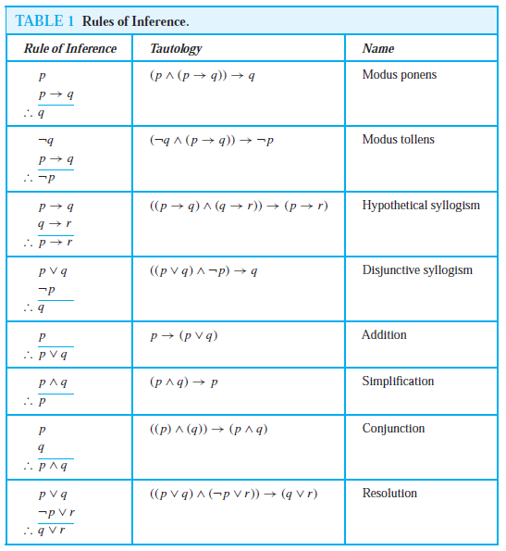
Proofs – Inference Rules

Slide 68
Proofs – Inference Rules
Example 04
“It is below freezing now. Therefore, it is either below freezing or raining now.”
p: “It is below freezing now”
q: “It is raining now”

Slide 69
Proofs – Inference Rules
Example 04
“It is below freezing now. Therefore, it is either below freezing or raining now.”
p: “It is below freezing now”
q: “It is raining now”
Argument form

Slide 70
Proofs – Inference Rules
Example 04
“It is below freezing now. Therefore, it is either below freezing or raining now.”
p: “It is below freezing now”
q: “It is raining now”
Argument form
p

Slide 71
Proofs – Inference Rules
Example 04
“It is below freezing now. Therefore, it is either below freezing or raining now.”
p: “It is below freezing now”
q: “It is raining now”
Argument form
p
p∨ q

Slide 72
Proofs – Inference Rules
Example 04
“It is below freezing now. Therefore, it is either below freezing or raining now.”
p: “It is below freezing now”
q: “It is raining now”
Argument form
p
p∨ q
Tautology
p → (p ∨ q )

Slide 73
Proofs – Inference Rules
Example 04
“It is below freezing now. Therefore, it is either below freezing or raining now.”
p: “It is below freezing now”
q: “It is raining now”
Argument form
p
p∨ q
Tautology
p → (p ∨ q )
Addition

Slide 74
Proofs – Inference Rules
Example 05
“It is below freezing and raining now. Therefore, it is below freezing now”
p: “It is below freezing now”
q: “It is raining now”

Slide 75
Proofs – Inference Rules
Example 05
“It is below freezing and raining now. Therefore, it is below freezing now”
p: “It is below freezing now”
q: “It is raining now”
Argument form

Slide 76
Proofs – Inference Rules
Example 05
“It is below freezing and raining now. Therefore, it is below freezing now”
p: “It is below freezing now”
q: “It is raining now”
Argument form
p ∧ q

Slide 77
Proofs – Inference Rules
Example 05
“It is below freezing and raining now. Therefore, it is below freezing now”
p: “It is below freezing now”
q: “It is raining now”
Argument form
p ∧ q
p

Slide 78
Proofs – Inference Rules
Example 05
“It is below freezing and raining now. Therefore, it is below freezing now”
p: “It is below freezing now”
q: “It is raining now”
Argument form
p ∧ q
p
Tautology
(p ∧ q) → p

Slide 79
Proofs – Inference Rules
Example 05
“It is below freezing and raining now. Therefore, it is below freezing now”
p: “It is below freezing now”
q: “It is raining now”
Argument form
p ∧ q
p
Tautology
(p ∧ q) → p
Simplification

Slide 80
Proofs – Inference Rules
Example 06
“If it rains today, then we will not have a barbecue today. If we do not have a barbecue today, then we will have a barbecue tomorrow. Therefore, if it rains today, then we will have a barbecue tomorrow”

Slide 81
Proofs – Inference Rules
Example 06
“If it rains today, then we will not have a barbecue today. If we do not have a barbecue today, then we will have a barbecue tomorrow. Therefore, if it rains today, then we will have a barbecue tomorrow”
p: “It is raining today”

Slide 82
Proofs – Inference Rules
Example 06
“If it rains today, then we will not have a barbecue today. If we do not have a barbecue today, then we will have a barbecue tomorrow. Therefore, if it rains today, then we will have a barbecue tomorrow”
p: “It is raining today”
q: “we will not have barbecue today”

Slide 83
Proofs – Inference Rules
Example 06
“If it rains today, then we will not have a barbecue today. If we do not have a barbecue today, then we will have a barbecue tomorrow. Therefore, if it rains today, then we will have a barbecue tomorrow”
p: “It is raining today”
q: “we will not have barbecue today”
r: “we will have barbecue tomorrow”

Slide 84
Proofs – Inference Rules
Example 06
“If it rains today, then we will not have a barbecue today. If we do not have a barbecue today, then we will have a barbecue tomorrow. Therefore, if it rains today, then we will have a barbecue tomorrow”
p: “It is raining today”
q: “we will not have barbecue today”
r: “we will have barbecue tomorrow”
Argument form

Slide 85
Proofs – Inference Rules
Example 06
“If it rains today, then we will not have a barbecue today. If we do not have a barbecue today, then we will have a barbecue tomorrow. Therefore, if it rains today, then we will have a barbecue tomorrow”
p: “It is raining today”
q: “we will not have barbecue today”
r: “we will have barbecue tomorrow”
Argument form
p → q

Slide 86
Proofs – Inference Rules
Example 06
“If it rains today, then we will not have a barbecue today. If we do not have a barbecue today, then we will have a barbecue tomorrow. Therefore, if it rains today, then we will have a barbecue tomorrow”
p: “It is raining today”
q: “we will not have barbecue today”
r: “we will have barbecue tomorrow”
Argument form
p → q
q → r

Slide 87
Proofs – Inference Rules
Example 06
“If it rains today, then we will not have a barbecue today. If we do not have a barbecue today, then we will have a barbecue tomorrow. Therefore, if it rains today, then we will have a barbecue tomorrow”
p: “It is raining today”
q: “we will not have barbecue today”
r: “we will have barbecue tomorrow”
Argument form
p → q
q → r
p → r

Slide 88
Proofs – Inference Rules
Example 06
“If it rains today, then we will not have a barbecue today. If we do not have a barbecue today, then we will have a barbecue tomorrow. Therefore, if it rains today, then we will have a barbecue tomorrow”
p: “It is raining today”
q: “we will not have barbecue today”
r: “we will have barbecue tomorrow”
Argument form
p → q
q → r
p → r
Tautology
(p → q) ∧ (q → r) → (p → r)

Slide 89
Proofs – Inference Rules
Example 06
“If it rains today, then we will not have a barbecue today. If we do not have a barbecue today, then we will have a barbecue tomorrow. Therefore, if it rains today, then we will have a barbecue tomorrow”
p: “It is raining today”
q: “we will not have barbecue today”
r: “we will have barbecue tomorrow”
Argument form
p → q
q → r
p → r
Tautology
(p → q) ∧ (q → r) → (p → r)
Hypothetical Syllogism

Slide 90
Proofs – Inference Rules
Example 07
“If it snows, then I will study discrete math. If I study discrete math, I will get an A. Therefore , If it snows, I will get an A”

Slide 91
Proofs – Inference Rules
Example 07
“If it snows, then I will study discrete math. If I study discrete math, I will get an A. Therefore , If it snows, I will get an A”
p: “It snows”
q: “I will study discrete math”
r: “I will get an A”

Slide 92
Proofs – Inference Rules
Example 07
“If it snows, then I will study discrete math. If I study discrete math, I will get an A. Therefore , If it snows, I will get an A”
p: “It snows”
q: “I will study discrete math”
r: “I will get an A”
Argument form
p → q
q → r
p → r

Slide 93
Proofs – Inference Rules
Example 07
“If it snows, then I will study discrete math. If I study discrete math, I will get an A. Therefore , If it snows, I will get an A”
p: “It snows”
q: “I will study discrete math”
r: “I will get an A”
Argument form
p → q
q → r
p → r
Tautology
(p → q) ∧ (q → r) → (p → r)

Slide 94
Proofs – Inference Rules
Example 07
“If it snows, then I will study discrete math. If I study discrete math, I will get an A. Therefore , If it snows, I will get an A”
p: “It snows”
q: “I will study discrete math”
r: “I will get an A”
Argument form
p → q
q → r
p → r
Tautology
(p → q) ∧ (q → r) → (p → r)
Hypothetical Syllogism

Slide 95
Proofs – Inference Rules
Example 08
“I will study discrete math or I will study English literature. I will not study discrete math. Therefore , I will study English literature”

Slide 96
Proofs – Inference Rules
Example 08
“I will study discrete math or I will study English literature. I will not study discrete math. Therefore , I will study English literature”
p: “I will study discrete math”
q: “I will study English literature”

Slide 97
Proofs – Inference Rules
Example 08
“I will study discrete math or I will study English literature. I will not study discrete math. Therefore , I will study English literature”
p: “I will study discrete math”
q: “I will study English literature”
Argument form
p ∨ q
¬ p
q

Slide 98
Proofs – Inference Rules
Example 08
“I will study discrete math or I will study English literature. I will not study discrete math. Therefore , I will study English literature”
p: “I will study discrete math”
q: “I will study English literature”
Argument form
p ∨ q
¬ p
q
Tautology
((p ∨ q) ∧ ¬ p )→ q

Slide 99
Proofs – Inference Rules
Example 08
“I will study discrete math or I will study English literature. I will not study discrete math. Therefore , I will study English literature”
p: “I will study discrete math”
q: “I will study English literature”
Argument form
p ∨ q
¬ p
q
Tautology
((p ∨ q) ∧ ¬ p )→ q
Disjunctive Syllogism

Slide 100
Proofs – Inference Rules
Example 9
“I will study discrete math. Therefore, I will study discrete math or I will visit Las Vegas.”

Slide 101
Proofs – Inference Rules
Example 9
“I will study discrete math. Therefore, I will study discrete math or I will visit Las Vegas.”
p: “I will study discrete math”
q: “I will visit Las Vegas”

Slide 102
Proofs – Inference Rules
Example 9
“I will study discrete math. Therefore, I will study discrete math or I will visit Las Vegas.”
p: “I will study discrete math”
q: “I will visit Las Vegas”
Argument form
p
p∨ q

Slide 103
Proofs – Inference Rules
Example 9
“I will study discrete math. Therefore, I will study discrete math or I will visit Las Vegas.”
p: “I will study discrete math”
q: “I will visit Las Vegas”
Argument form
p
p∨ q
Tautology
p → (p ∨ q )

Slide 104
Proofs – Inference Rules
Example 9
“I will study discrete math. Therefore, I will study discrete math or I will visit Las Vegas.”
p: “I will study discrete math”
q: “I will visit Las Vegas”
Argument form
p
p∨ q
Tautology
p → (p ∨ q )
Addition

Slide 105
Proofs – Inference Rules
Example 10
“I will study discrete math and English literature. Therefore, I will study discrete math”

Slide 106
Proofs – Inference Rules
Example 10
“I will study discrete math and English literature. Therefore, I will study discrete math”
p: “I will study discrete math”
q: “I will study English literature”

Slide 107
Proofs – Inference Rules
Example 10
“I will study discrete math and English literature. Therefore, I will study discrete math”
p: “I will study discrete math”
q: “I will study English literature”
Argument form
p ∧ q
p

Slide 108
Proofs – Inference Rules
Example 10
“I will study discrete math and English literature. Therefore, I will study discrete math”
p: “I will study discrete math”
q: “I will study English literature”
Argument form
p ∧ q
p
Tautology
(p ∧ q) → p

Slide 109
Proofs – Inference Rules
Example 10
“I will study discrete math and English literature. Therefore, I will study discrete math”
p: “I will study discrete math”
q: “I will study English literature”
Argument form
p ∧ q
p
Tautology
(p ∧ q) → p
Simplification

Slide 110
Proofs – Inference Rules
Example 11
“I will study discrete math. I will study English literature. Therefore, I will study discrete math and I will study English literature”
p: “I will study discrete math”
q: “I will study English literature”

Slide 111
Proofs – Inference Rules
Example 11
“I will study discrete math. I will study English literature. Therefore, I will study discrete math and I will study English literature”
p: “I will study discrete math”
q: “I will study English literature”
Argument form
p
q
p ∧ q

Slide 112
Proofs – Inference Rules
Example 11
“I will study discrete math. I will study English literature. Therefore, I will study discrete math and I will study English literature”
p: “I will study discrete math”
q: “I will study English literature”
Argument form
p
q
p ∧ q
Tautology
((p) ∧ (q))→ (p ∧ q)

Slide 113
Proofs – Inference Rules
Example 11
“I will study discrete math. I will study English literature. Therefore, I will study discrete math and I will study English literature”
p: “I will study discrete math”
q: “I will study English literature”
Argument form
p
q
p ∧ q
Tautology
((p) ∧ (q))→ (p ∧ q)
Conjunction

Slide 114
Proofs – Inference Rules
Example 12
“I will not study discrete math or I will study English literature. I will study discrete math or I will study databases. Therefore, I will study databases or I will study English literature”

Slide 115
Proofs – Inference Rules
Example 12
“I will not study discrete math or I will study English literature. I will study discrete math or I will study databases. Therefore, I will study databases or I will study English literature”
p: “I will study discrete math”

Slide 116
Proofs – Inference Rules
Example 12
“I will not study discrete math or I will study English literature. I will study discrete math or I will study databases. Therefore, I will study databases or I will study English literature”
p: “I will study discrete math”
r: “I will study English literature”

Slide 117
Proofs – Inference Rules
Example 12
“I will not study discrete math or I will study English literature. I will study discrete math or I will study databases. Therefore, I will study databases or I will study English literature”
p: “I will study discrete math”
r: “I will study English literature”
q: “I will study Databases”

Slide 118
Proofs – Inference Rules
Example 12
“I will not study discrete math or I will study English literature. I will study discrete math or I will study databases. Therefore, I will study databases or I will study English literature”
p: “I will study discrete math”
r: “I will study English literature”
q: “I will study Databases”
Argument form

Slide 119
Proofs – Inference Rules
Example 12
“I will not study discrete math or I will study English literature. I will study discrete math or I will study databases. Therefore, I will study databases or I will study English literature”
p: “I will study discrete math”
r: “I will study English literature”
q: “I will study Databases”
Argument form
¬p ∨ r

Slide 120
Proofs – Inference Rules
Example 12
“I will not study discrete math or I will study English literature. I will study discrete math or I will study databases. Therefore, I will study databases or I will study English literature”
p: “I will study discrete math”
r: “I will study English literature”
q: “I will study Databases”
Argument form
¬p ∨ r
p ∨ q

Slide 121
Proofs – Inference Rules
Example 12
“I will not study discrete math or I will study English literature. I will study discrete math or I will study databases. Therefore, I will study databases or I will study English literature”
p: “I will study discrete math”
r: “I will study English literature”
q: “I will study Databases”
Argument form
¬p ∨ r
p ∨ q
q ∨ r

Slide 122
Proofs – Inference Rules
Example 12
“I will not study discrete math or I will study English literature. I will study discrete math or I will study databases. Therefore, I will study databases or I will study English literature”
p: “I will study discrete math”
r: “I will study English literature”
q: “I will study Databases”
Argument form
¬p ∨ r
p ∨ q
q ∨ r
Tautology
((¬p ∨ r ) ∧ (p ∨ q)) →(q ∨ r)

Slide 123
Proofs – Inference Rules
Example 12
“I will not study discrete math or I will study English literature. I will study discrete math or I will study databases. Therefore, I will study databases or I will study English literature”
p: “I will study discrete math”
r: “I will study English literature”
q: “I will study Databases”
Argument form
¬p ∨ r
p ∨ q
q ∨ r
Tautology
((¬p ∨ r ) ∧ (p ∨ q)) →(q ∨ r)
Resolution

Slide 124
Validity of Arguments
Building Arguments

Slide 125
Proof – Building Arguments
Introduction
A valid argument is a sequence of statements. Each statement is either a premise or follows from previous statements by rules of inference.

Slide 126

Proof – Building Arguments
Introduction
A valid argument is a sequence of statements. Each statement is either a premise or follows from previous statements by rules of inference.

Slide 127
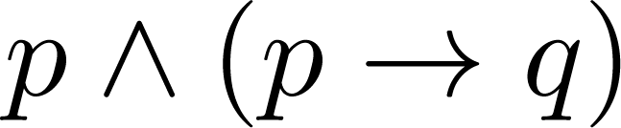
Proof – Building Arguments
Example 01
Show that “q” is a conclusion of the following proposition.

Slide 128
Proof – Building Arguments
Example 01
Show that “q” is a conclusion of the following proposition.

Slide 129
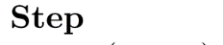
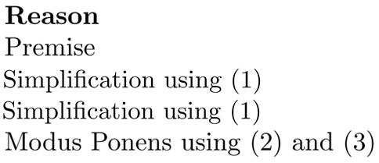
Proof – Building Arguments
Example 01
Show that “q” is a conclusion of the following proposition.

Slide 130
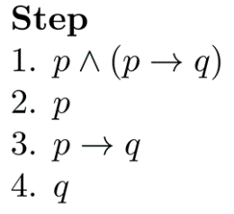
Proof – Building Arguments
Example 01
Show that “q” is a conclusion of the following proposition.

Slide 131
Proof – Building Arguments
Example 01
Show that “q” is a conclusion of the following proposition.

Slide 132
Proof – Building Arguments
Example 01
Show that “q” is a conclusion of the following proposition.

Slide 133
Proof – Building Arguments
Example 01
Show that “q” is a conclusion of the following proposition.

Slide 134
Proof – Building Arguments
Example 01
Show that “q” is a conclusion of the following proposition.

Slide 135
Proof – Building Arguments
Example 01
Show that “q” is a conclusion of the following proposition.

Slide 136
Proof – Building Arguments
Example 01
Show that “q” is a conclusion of the following proposition.

Slide 137

Proof – Building Arguments
Example 01
Show that “q” is a conclusion of the following proposition.

Slide 138
Proof – Building Arguments
Example 02
With these hypotheses:
“It is not sunny this afternoon and it is colder than yesterday.”
“We will go swimming only if it is sunny.”
“If we do not go swimming, then we will take a canoe trip.”
“If we take a canoe trip, then we will be home by sunset.”
Using the inference rules, construct a valid argument for the conclusion:
“We will be home by sunset.”

Slide 139
Proof – Building Arguments
Example 02
With these hypotheses:
“It is not sunny this afternoon and it is colder than yesterday.”
“We will go swimming only if it is sunny.”
“If we do not go swimming, then we will take a canoe trip.”
“If we take a canoe trip, then we will be home by sunset.”
Propositions
p : “It is sunny this afternoon.” r : “We will go swimming.”
t : “We will be home by sunset.”
q : “It is colder than yesterday.” s : “We will take a canoe trip.”

Slide 140
Proof – Building Arguments
Example 02
With these hypotheses:
“It is not sunny this afternoon and it is colder than yesterday.”
“We will go swimming only if it is sunny.”
“If we do not go swimming, then we will take a canoe trip.”
“If we take a canoe trip, then we will be home by sunset.”
Propositions
p : “It is sunny this afternoon.” r : “We will go swimming.”
t : “We will be home by sunset.”
q : “It is colder than yesterday.” s : “We will take a canoe trip.”

Slide 141
Proof – Building Arguments
Example 02
With these hypotheses:
“It is not sunny this afternoon and it is colder than yesterday.”
“We will go swimming only if it is sunny.”
“If we do not go swimming, then we will take a canoe trip.”
“If we take a canoe trip, then we will be home by sunset.”
Propositions
p : “It is sunny this afternoon.” r : “We will go swimming.”
t : “We will be home by sunset.”
q : “It is colder than yesterday.” s : “We will take a canoe trip.”

Slide 142
Proof – Building Arguments
Example 02
With these hypotheses:
“It is not sunny this afternoon and it is colder than yesterday.”
“We will go swimming only if it is sunny.”
“If we do not go swimming, then we will take a canoe trip.”
“If we take a canoe trip, then we will be home by sunset.”
Propositions
p : “It is sunny this afternoon.” r : “We will go swimming.”
t : “We will be home by sunset.”
q : “It is colder than yesterday.” s : “We will take a canoe trip.”

Slide 143
Proof – Building Arguments
Example 02
With these hypotheses:
“It is not sunny this afternoon and it is colder than yesterday.”
“We will go swimming only if it is sunny.”
“If we do not go swimming, then we will take a canoe trip.”
“If we take a canoe trip, then we will be home by sunset.”
Propositions
p : “It is sunny this afternoon.” r : “We will go swimming.”
t : “We will be home by sunset.”
q : “It is colder than yesterday.” s : “We will take a canoe trip.”

Slide 144
Proof – Building Arguments
Example 02
With these hypotheses:
“It is not sunny this afternoon and it is colder than yesterday.”
“We will go swimming only if it is sunny.”
“If we do not go swimming, then we will take a canoe trip.”
“If we take a canoe trip, then we will be home by sunset.”
Propositions
p : “It is sunny this afternoon.” r : “We will go swimming.”
t : “We will be home by sunset.”
q : “It is colder than yesterday.” s : “We will take a canoe trip.”

Slide 145
Proof – Building Arguments
Example 02
With these hypotheses:
“It is not sunny this afternoon and it is colder than yesterday.”
“We will go swimming only if it is sunny.”
“If we do not go swimming, then we will take a canoe trip.”
“If we take a canoe trip, then we will be home by sunset.”
Propositions
p : “It is sunny this afternoon.” r : “We will go swimming.”
t : “We will be home by sunset.” (Conclusion)
q : “It is colder than yesterday.” s : “We will take a canoe trip.”

Slide 146
Proof – Building Arguments
Construct Valid Argument

Slide 147
Proof – Building Arguments
Construct Valid Argument
Conclusion
t

Slide 148
Proof – Building Arguments
Construct Valid Argument

Slide 149
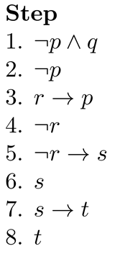
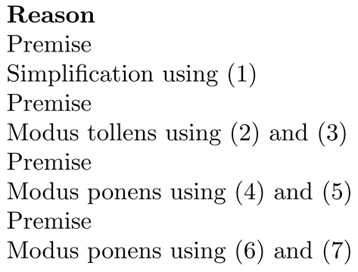
Proof – Building Arguments
Construct Valid Argument

Slide 150
Proof – Building Arguments
Construct Valid Argument

Slide 151
Proof – Building Arguments
Construct Valid Argument

Slide 152
Proof – Building Arguments
Construct Valid Argument

Slide 153
Proof – Building Arguments
Construct Valid Argument

Slide 154
Proof – Building Arguments
Construct Valid Argument

Slide 155
Proof – Building Arguments
Construct Valid Argument

Slide 156
Proof – Building Arguments
Construct Valid Argument

Slide 157
Proof – Building Arguments
Construct Valid Argument

Slide 158
Proof – Building Arguments
Construct Valid Argument

Slide 159
Proof – Building Arguments
Construct Valid Argument

Slide 160
Proof – Building Arguments
Construct Valid Argument

Slide 161
Proof – Building Arguments
Construct Valid Argument

Slide 162
Proof – Building Arguments
Construct Valid Argument

Slide 163
Proof – Building Arguments
Construct Valid Argument

Slide 164
Proof – Building Arguments
Construct Valid Argument

Slide 165
Proof – Building Arguments
Construct Valid Argument

Slide 166
Proof – Building Arguments
Construct Valid Argument

Slide 167

Proof – Building Arguments
Construct Valid Argument

Slide 168
Proof – Building Arguments
Example 3:
Show that the premises
“If you send me an e-mail message, then I will finish writing the program,”
“If you do not send me an e-mail message, then I will go to sleep early,” and
“If I go to sleep early, then I will wake up feeling refreshed”
lead to the conclusion
“If I do not finish writing the program, then I will wake up feeling refreshed.”

Slide 169
Proof – Building Arguments
Example 3 (Contd…):
Let p be the proposition “You send me an e-mail message,”
q the proposition “I will finish writing the program,”
r the proposition “I will go to sleep early,” and
s the proposition “I will wake up feeling refreshed.”
Then the premises are p → q, ¬p → r, and r → s.
The desired conclusion is ¬q → s

Slide 170
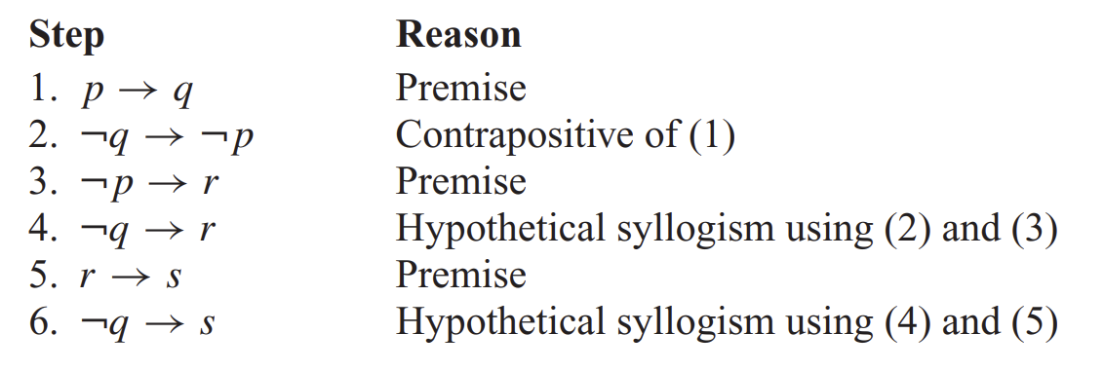
Proof – Building Arguments
Example 3 (Contd…):

Slide 171
Proof – Building Arguments
Example 4:
Show that the premises (p ∧ q) ∨ r and r → s imply the conclusion p ∨ s.
Solution:
Step Reason
1. (p ∧ q) ∨ r Premise
2. (p ∨ r) ∧ (q ∨ r) Distributive Law on 1
3. p ∨ r Simplification of 2
4. r → s Premise
5. ¬r ∨ s Equivalent statement of 3
6. p ∨ s Resolution of 3 and 5

Slide 172
Proof – Inference Rules
Quantified Statements
A valid argument for quantified statements is a sequence of statements. Each statement is either a premise or follows from previous statements by rules of inference.
Universal Instantiation (UI)
Universal Generalization (UG)
Existential Instantiation (EI)
Existential Generalization (EG)

Slide 173
Proof – Inference Rules
Universal Instantiation (UI)

Slide 174
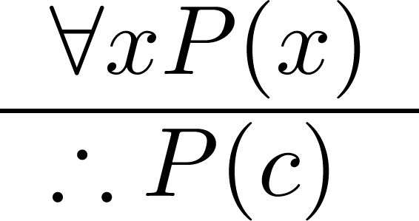
Proof – Inference Rules
Universal Instantiation (UI)

Slide 175
Proof – Inference Rules
Universal Instantiation (UI)
Example:
Our domain consists of all dogs and Fido is a dog.
“All dogs are cuddly.”
“Therefore, Fido is cuddly.”

Slide 176
Proof – Inference Rules
Universal Generalization (UG)

Slide 177
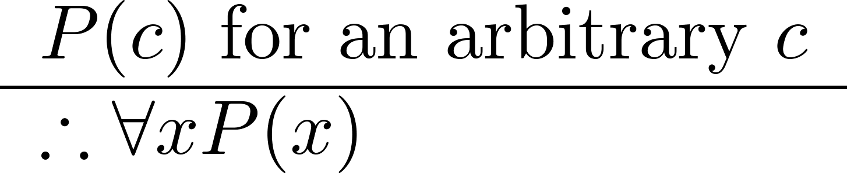
Proof – Inference Rules
Universal Generalization (UG)

Slide 178
Proof – Inference Rules
Universal Generalization (UG)
Example:
Used often implicitly in Mathematical Proofs

Slide 179
Proof – Inference Rules
Existential Instantiation (EI)

Slide 180
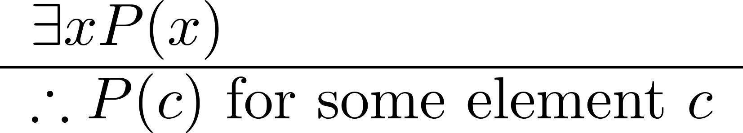
Proof – Inference Rules
Existential Instantiation (EI)

Slide 181
Proof – Inference Rules
Existential Instantiation (EI)
Example:
“There is someone who got an A in the course.”
“Let’s call her a and say that a got an A”

Slide 182
Proof – Inference Rules
Existential Generalization (EG)

Slide 183
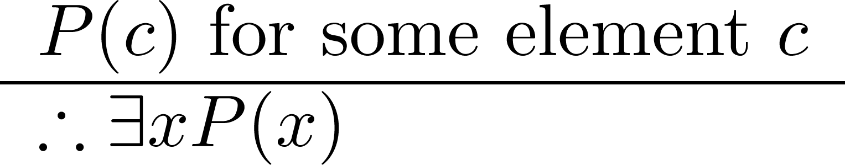
Proof – Inference Rules
Existential Generalization (EG)

Slide 184
Proof – Inference Rules
Existential Generalization (EG)
Example:
“Michelle got an A in the class.”
“Therefore, someone got an A in the class.”

Slide 185
Proofs – Inference Rules
Example 01
Show that the premises “Everyone in this discrete mathematics class has taken a course in computer science” and “Maria is a student in this class” imply the conclusion “Maria has taken a course in computer science.”

Slide 186
Proofs – Inference Rules
Example 01 (Contd…)
Solution:
Let D(x) denote “x is in this discrete mathematics class,” and C(x) denote “x has taken a course in computer science.”
Then the premises are ∀x(D(x) → C(x)) and D(Maria).
The conclusion is C(Maria).

Slide 187
Proofs – Inference Rules
Example 01 (Contd…)
Solution:
Step Reason
1. ∀x(D(x) → C(x)) Premise
2. D(Maria) → C(Maria) Universal instantiation from (1)
3. D(Maria) Premise
4. C(Maria) Modus ponens from (2) and (3)

Slide 188
Proofs – Inference Rules
Example 02
“Every man has two legs.” “John Smith is a man.” Therefore , “John Smith has two legs”

Slide 189
Proofs – Inference Rules
Example 02
“Every man has two legs.” “John Smith is a man.” Therefore , “John Smith has two legs”
M(x): “x is a man”

Slide 190
Proofs – Inference Rules
Example 02
“Every man has two legs.” “John Smith is a man.” Therefore , “John Smith has two legs”
M(x): “x is a man”
L(x): “x has two legs”

Slide 191

Proofs – Inference Rules
Example 02
“Every man has two legs.” “John Smith is a man.” Therefore , “John Smith has two legs”
M(x): “x is a man”
L(x): “x has two legs”
Argument:

Slide 192
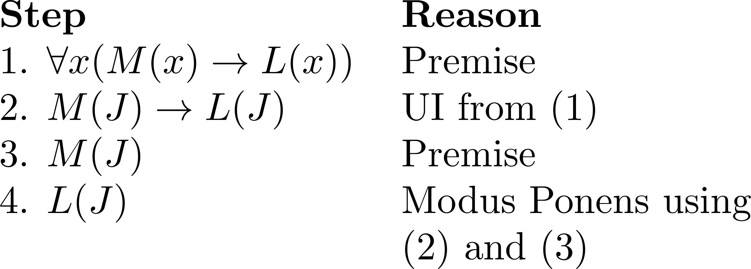
Proofs – Inference Rules
Example 02
“Every man has two legs.” “John Smith is a man.” Therefore , “John Smith has two legs”
M(x): “x is a man”
L(x): “x has two legs”
Argument:

Slide 193
Proofs – Inference Rules
Example 02
“Every man has two legs.” “John Smith is a man.” Therefore , “John Smith has two legs”
M(x): “x is a man”
L(x): “x has two legs”
Argument:

Slide 194
Proofs – Inference Rules
Example 02
“Every man has two legs.” “John Smith is a man.” Therefore , “John Smith has two legs”
M(x): “x is a man”
L(x): “x has two legs”
Argument:

Slide 195
Proofs – Inference Rules
Example 02
“Every man has two legs.” “John Smith is a man.” Therefore , “John Smith has two legs”
M(x): “x is a man”
L(x): “x has two legs”
Argument:

Slide 196
Proofs – Inference Rules
Example 02
“Every man has two legs.” “John Smith is a man.” Therefore , “John Smith has two legs”
M(x): “x is a man”
L(x): “x has two legs”
Argument:

Slide 197

Proofs – Inference Rules
Example 02
“Every man has two legs.” “John Smith is a man.” Therefore , “John Smith has two legs”
M(x): “x is a man”
L(x): “x has two legs”
Argument:

Slide 198
Proofs – Inference Rules
Example 03
“A student in this class has not read the book” “Everyone in this class passed the first exam” Therefore , “Someone who passed the first exam has not read the book”
C(x): “x is in this class”
B(x): “x has read the book”
P(x): “x passed the first exam”
Argument:

Slide 199
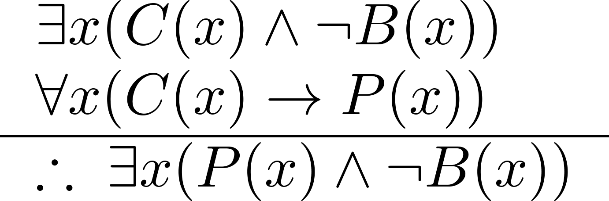
Proofs – Inference Rules
Example 03
“A student in this class has not read the book” “Everyone in this class passed the first exam” Therefore , “Someone who passed the first exam has not read the book”
C(x): “x is in this class”
B(x): “x has read the book”
P(x): “x passed the first exam”
Argument:

Slide 200
Proofs – Inference Rules
Example 03
“A student in this class has not read the book” “Everyone in this class passed the first exam” Therefore , “Someone who passed the first exam has not read the book”
C(x): “x is in this class”
B(x): “x has read the book”
P(x): “x passed the first exam”
Argument:

Slide 201
Proofs – Inference Rules
Example 03
“A student in this class has not read the book” “Everyone in this class passed the first exam” Therefore , “Someone who passed the first exam has not read the book”
C(x): “x is in this class”
B(x): “x has read the book”
P(x): “x passed the first exam”
Argument:

Slide 202
Proofs – Inference Rules
Construct Valid Argument

Slide 203
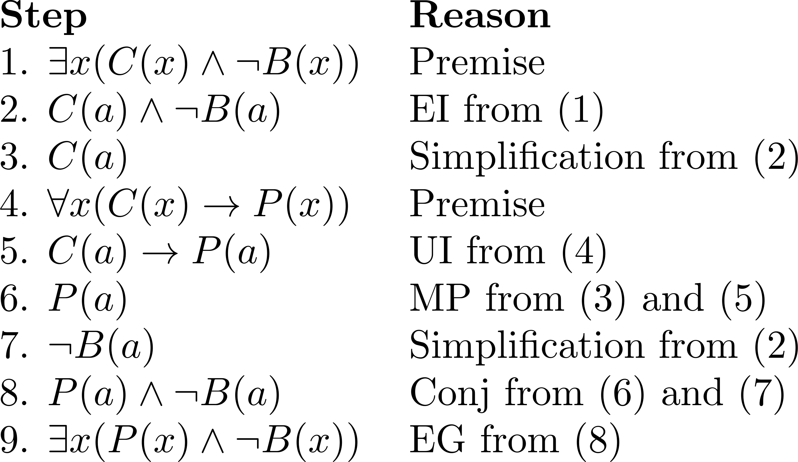
Proofs – Inference Rules
Construct Valid Argument

Slide 204
Proofs – Inference Rules
Construct Valid Argument

Slide 205
Proofs – Inference Rules
Construct Valid Argument

Slide 206
Proofs – Inference Rules
Construct Valid Argument

Slide 207
Proofs – Inference Rules
Construct Valid Argument

Slide 208
Proofs – Inference Rules
Construct Valid Argument

Slide 209
Proofs – Inference Rules
Construct Valid Argument

Slide 210
Proofs – Inference Rules
Construct Valid Argument

Slide 211
Proofs – Inference Rules
Construct Valid Argument

Slide 212
Proofs – Inference Rules
Construct Valid Argument

Slide 213
Proofs – Valid Arguments
Example 04
“All men are mortal. Socrates is a man”, Therefore “Socrates is mortal”
Argument

Slide 214
Proofs – Inference Rules
Construct Valid Argument

Slide 215
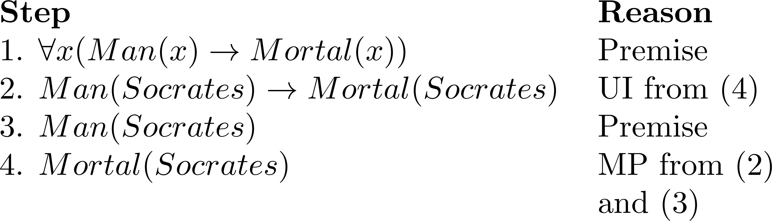
Proofs – Inference Rules
Construct Valid Argument

Slide 216
Proofs – Inference Rules
Construct Valid Argument

Slide 217
Proofs – Inference Rules
Construct Valid Argument

Slide 218
Proofs – Inference Rules
Construct Valid Argument

Slide 219
Proofs – Inference Rules
Construct Valid Argument

Slide 220
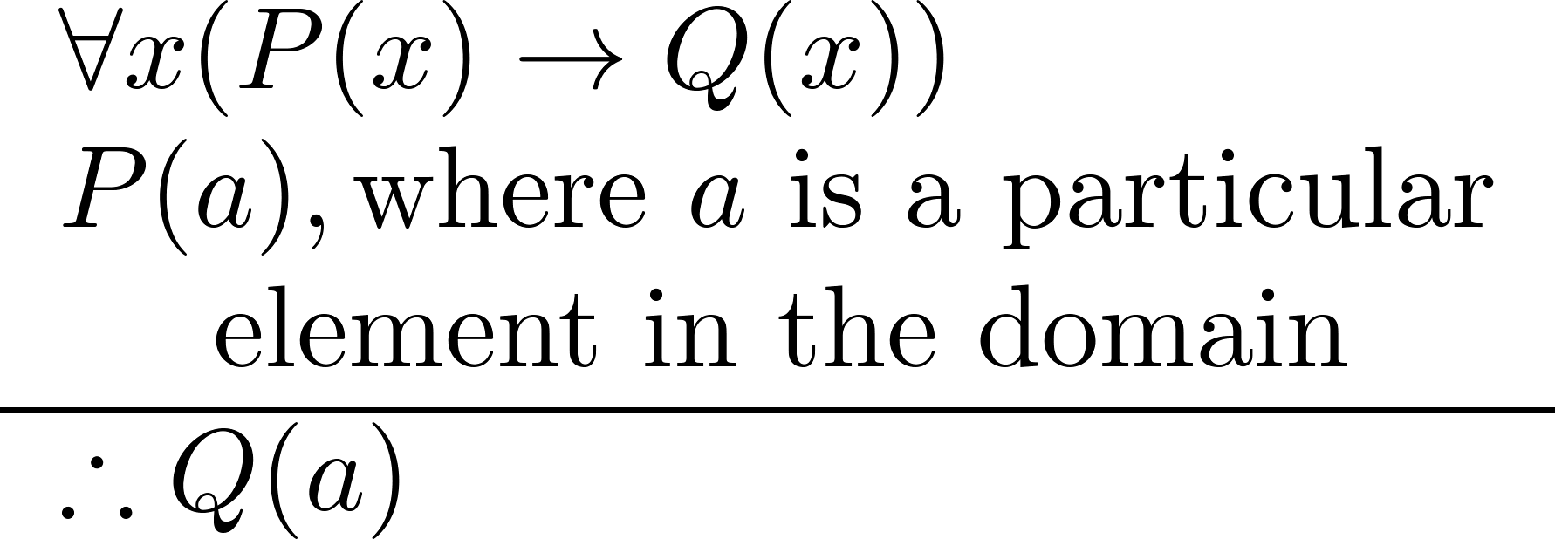
Proof – Inference Rules
Universal Modus Ponens
Universal Modus Ponens combines universal instantiation and modus ponens into one rule
Example:
This rule could be used in the Socrates example

Slide 221
Proof – Inference Rules
Example:
Assume that “For all positive integers n, if n is greater than 4, then n² is less than 2^{n}” is true. Use universal modus ponens to show that
100² < 2¹⁰⁰.
Solution:
Let P (n) denote “n > 4” and Q(n) denote “n² < 2^{n}.”
Then the given statements can be represented by
∀n(P (n) → Q(n)), where the domain consists of all positive integers.
We are assuming that ∀n(P (n) → Q(n)) is true.
Then we see that P(100) is true because 100 > 4.
It follows by universal modus ponens that Q(100) is also true, namely that 100² < 2¹⁰⁰.

Slide 222
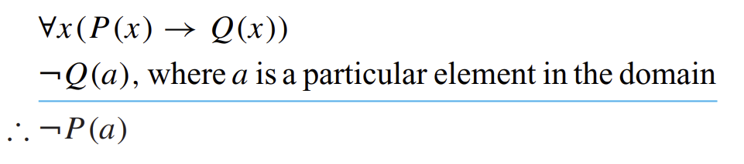
Proof – Inference Rules
Universal Modus Tollens
Universal Modus Tollens combines universal instantiation and Modus Tollens into one rule

